Slide 1


Slide 2


Slide 3





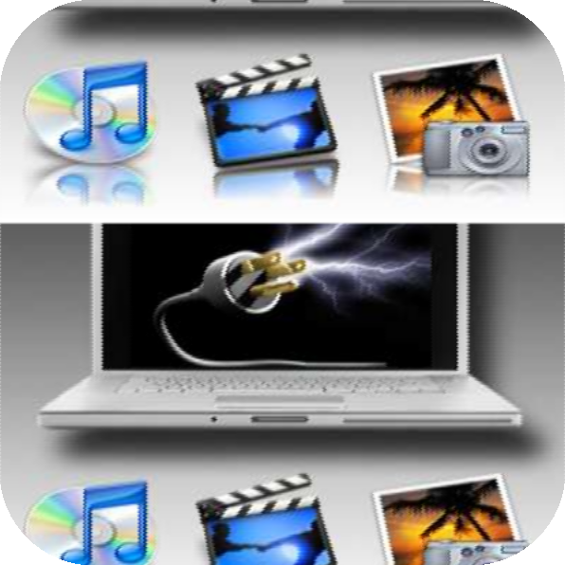



MULTI
Many or more than one
MEDIA
Medium of Communication

Slide 4

Multimedia is a combination of
text, graphic, sound, animation, and video that is delivered interactively to the user by electronic or digitally manipulated means.
Multimedia includes a combination of
Text
Audio
Still images
Animation video

Slide 5


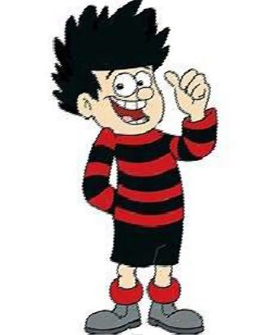




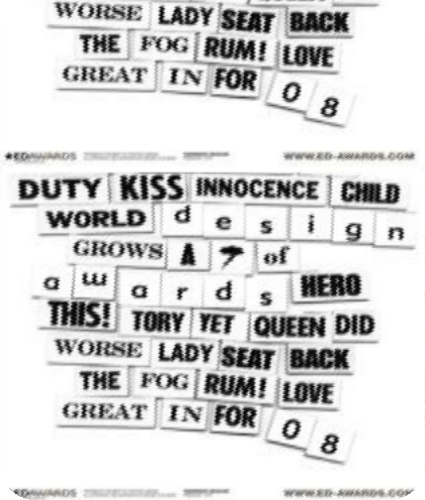



Text
Audio
Graphics
Video
Animation

Slide 6


TEXT
A broad term for something that contains words to express something.
Text is the most basic element of multimedia.
A good choice of words could help convey the intended message to the users (keywords).
Used in contents, menus, navigational buttons

Slide 7
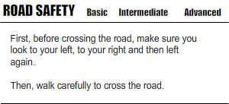
Example

Slide 8

GRAPHIC
Two-dimensional figure or illustration
Could be produced manually (by
drawing, painting, carving, etc.) or by computer graphics technology.
Used in multimedia to show more clearly what a particular information is all about (diagrams, picture).

Slide 9
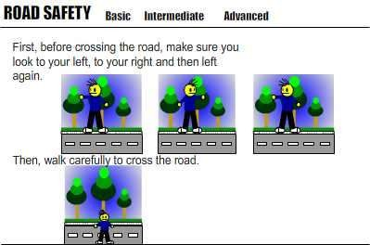
GRAPHIC
Example

Slide 10

AUDIO
Produced by vibration, as perceived by the sense of hearing.
In multimedia, audio could come in the form of speech, sound effects and also music score.

Slide 11
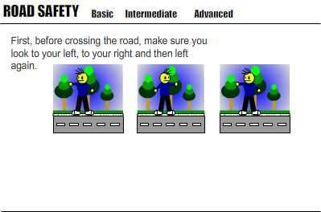
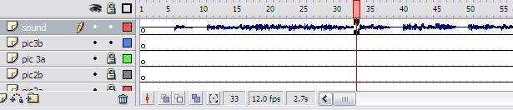
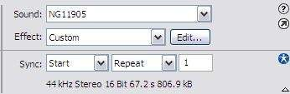
AUDIO
Example

Slide 12
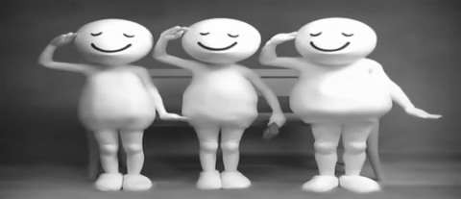
ANIMATION
The illusion of motion created by the consecutive display of images of static elements.
In multimedia, animation is used to further enhance / enriched the experience of the user to further understand the information conveyed to them.

Slide 13
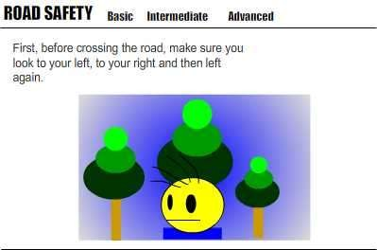
ANIMATION
Example

Slide 14

VIDEO
Is the technology of
capturing, recording, processing, transmitting, and reconstructing moving pictures.
Video is more towards photo realistic image sequence / live recording as in comparison to animation.
Video also takes a lot of storage space. So plan carefully before you are going to use it.

Slide 15

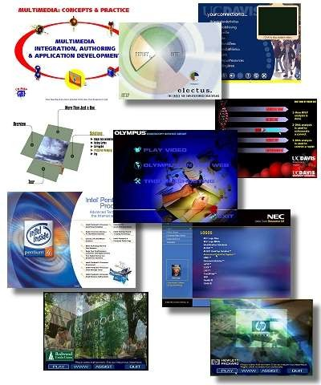
There are a number of fields where multimedia could be of use. Examples are:-
Business
Education
Entertainment
Home
Public Places

Slide 16

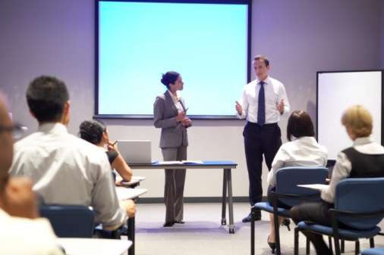
BUSINESS
Use and Applications
Sales / Marketing Presentation
Trade show production
Company Kiosk

Slide 17

EDUCATION
Use and Applications
E-Learning / Distance Learning
Information Searching

Slide 18
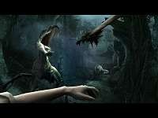
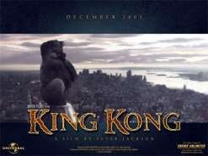
ENTERTAINMENT
Use and Applications
Games (Leisure / Educational)
Movies
Online

Slide 19



HOME
Use and Applications
Television
Satellite TV
SMS services (chats, voting, reality TV)

Slide 20
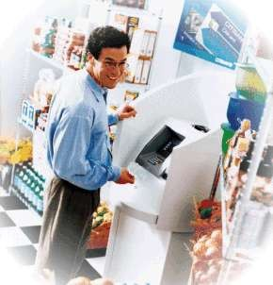
PUBLIC PLACES
Use and Applications
Information Kiosk
Smart Cards, Security

Slide 21


Slide 22

Briefing Products
Reference Products
Database Products
Education and Training Products
Kiosk
Entertainment and Games

Slide 23
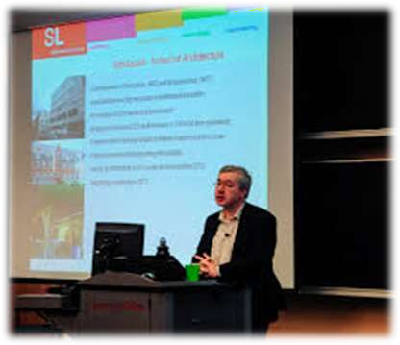
BRIEFING PRODUCTS
A design brief is a written document for a design project
developed in concert by a person representing the business need for design and the designer.
2/2

Slide 24

Good briefing presentation depends on:
The understanding of the presented subject.
Consistent layout
Example:
Corporate Presentation
Sales Presentation
Educational Lectures

Slide 25
REFERENCE PRODUCTS
Often used for answering specific questions or for general browsing of information. (stored on CD/ DVD ROM)
Characteristic of reference product:
Used by wide range of user (small – adult)(E.g.:
Britannica)
Have navigational menu(E.g.: GPS), book marking.
1/2

Slide 26
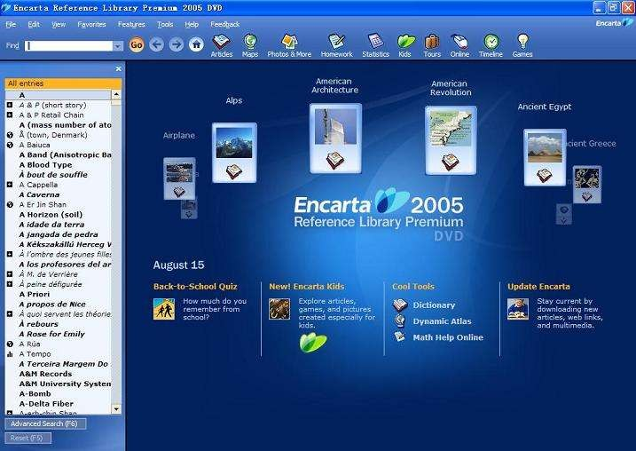
REFERENCE PRODUCTS
Example:
2/2

Slide 27
EDUCATION AND TRAINING PRODUCTS
Similar to textbook or training manuals but have added media such as audio, animation and video.
Make up a significant share of the multimedia market ranging from pre-kindergarten to postgraduate offerings from technical to corporate training products.
1/2

Slide 28
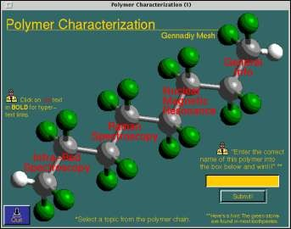
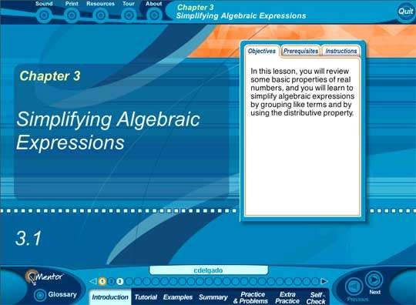
EDUCATION AND TRAINING PRODUCTS…
Example
2/2

Slide 29
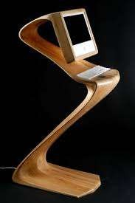
KIOSK PRODUCTS
A product which is usually stationed at public places and allow the user to find information interactively and also other types of transaction.
Characteristics of Kiosk Products:-
Limited target users and usage.
User friendly and easily used by user.
Fast response.
1/2

Slide 30
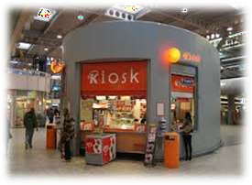
KIOSK PRODUCTS….
Categories of Kiosk
Point Of Information
Provide certain information ( map, timetable )
Point Of Sales System
Allow users to purchase or make orders
Example of Kiosk Products:-
Instant Photo Booth
Banking Kiosk (money deposit, cheque)
University Information Kiosk
2/2

Slide 31
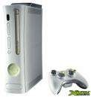
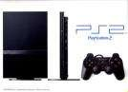
ENTERTAINMENT & GAMES
Most popular
Shipped in the form of Interactive CD / DVD ROM.
Characteristics of E & G Products:-
Requires constant feedback and interaction with the user.
Challenging and sometimes intriguing for user
Enabled online play for more than one user experience.

Slide 32


Refers to creation, Storage and manipulation of pictures and drawing using a digital computer.
Effective tool for presenting information.
Computer aided design.
Computer aided manufacturing.

Slide 33

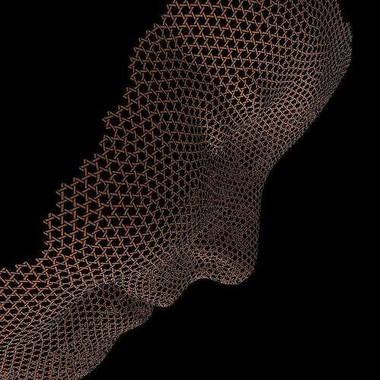
Simple or
Active Computer Graphics
Interactive or
passive computer graphics

Slide 34
Passive
Active
Control
Control
No Control
Communication
One Way Communication
Interaction
No Interaction b/w User
and H/W
Earlier supported
Motion & Updating
No facility
Dynamic nature
Communication
2-Way Communication
Interaction
High bandwidth user
interaction
Modern Applications
Motion & Updation
2-D, 3-D Transformations

Slide 35


User Interface
Interactive Plotting in Science Business and technology.
Office Automation & E-Publishing.

Slide 36


Process Control
Cartography
Simulation, Animation for Scientific Visualization and Entertainment.
Art and Commerce

Slide 37


Circuit Drawings
Real-time Animations
Virtual-Reality Environments
Architectural Drawings

Slide 38

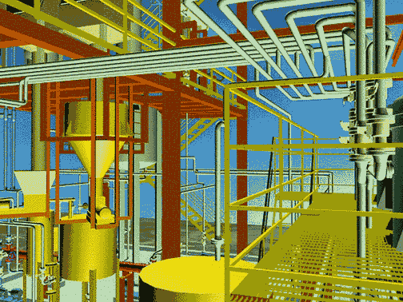
Software: AutoCAD and 3D Studio Max

Slide 39

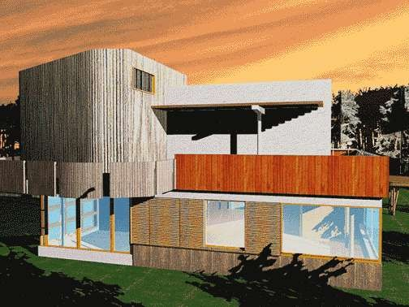

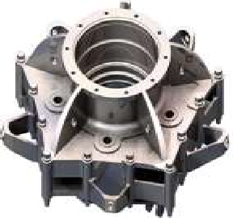
Software: AutoCAD and 3D Studio Max R2
Towards Virtual
Manufacturing

Slide 40

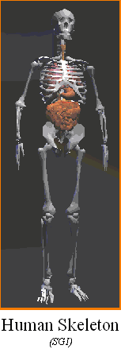
Computer Graphics is almost used in every field to teach and train
Medicine
Human Anatomy Models
Engineering
Animated Models : Explaining the working of different models
Fashion Designing
Designing and Creating new Patterns

Slide 41

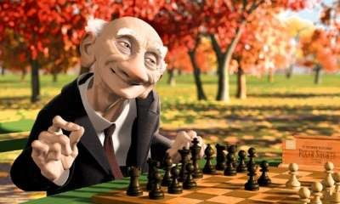
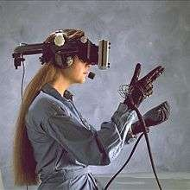

Motion Pictures
Music Videos
Television Shows
Games

Slide 42

THANK YOU

